Slide 1
Computing Theory
Lecture 1: Subject Briefing & Introduction

Slide 2
Lecturer information
Lecturer Name: Farhana Illiani bt Hassan
Email: farhana.illiani@apu.edu.my
Office: SOC, Level 5
Communication:
  Staff room @level 5 (physical meeting)
  Microsoft Teams (online)
Computing Theory Dr.A.Bazila Banu

Slide 3
Resources
Main Reference
Hopcroft, J.E, Motwani, R., Ullman, J.D. (2007), Introduction to Automata Theory, Languages, and Computation (3rd Edition). Pearson (ISBN: 978-0321455369)
Sipser, M. (2012). Introduction to the Theory of Computation (3rd Edition). Course Technology (ISBN: 978-1133187790)
Maheshwari, A., Smid, M. (2014), Introduction to Theory of Computation. Carleton University, Ottowa CA. e-book available at: http://cglab.ca/~michiel/TheoryOfComputation/TheoryOfComputation.pdf
References:
Sudkamp, T. (2006), Languages and Machines: An Introduction to the Theory of Computer Science (3rd Edition). Pearson (978-0321322210)
Goddard, W. (2008), Introducing the Theory of Computation. Jones & Bartlett Learning (ISBN: 978-0763741259)
Cohen D. I. A. (1997), Introduction to Computer Theory (2nd Edition). John Wiley & Sons (SBN: 978-0471137726)
Computing Theory Dr.A.Bazila Banu

Slide 4
Objective
1. Contribute to the achievement of the learning outcomes specified for the student’s award at Level 2.
2. Meet the prerequisite requirements of modules at Level 3 of study.
3. Provide an introduction to the study of formal models of computation.
4. Introduce and begin to develop student skills in relation to the use of automata, regular expressions, and context-free grammars.
5. Introduce and begin to develop lifelong learning skills of independent learning and study in relation to computational capabilities and their limitations.
6. Introduce students to the knowledge, skills and techniques relevant to the theory of computation and complexity studies.
7. Enable students to develop their ability to:
Critically analyze problems and understand theoretical foundations
Design solution methods and understand their limitations
Learn from varied sources
Computing Theory Dr.A.Bazila Banu

Slide 5
Learning Outcomes
Design automata and generate regular expressions for specified languages.
Design and analyse context-free grammars for specific syntactic rules.
Describe and Design Turing machines to accomplish specified computations.
Explain and discuss complexity and decidability of problems.
Computing Theory Dr.A.Bazila Banu

Slide 6
Assesment
Group Assignment :50%
Final Exam :50%
Computing Theory Dr.A.Bazila Banu

Slide 7
What is expected of you
You should abide to all the rules & regulation of APU
  Proper attire.
  No speaking of dialects.
  Attendance is compulsory and valid medical certificates or letters from parents /guardians must support any absence from class.
  Three lateness will be equal to one absence.
  All pagers and handphones should be turned off during lectures.
Slide <number> of 21

Slide 8
Why we need Computing Theory
To understand the nature of efficient computation
  The Theory of Computation provides a new viewpoint on old phenomena.
  The Theory of Computation is also concerned with finding the most efficient methods for solving specific problems.
    For example, multiplying numbers can be done more efficient than via the adding the numbers repeatedly
Computing Theory Dr.A.Bazila Banu

Slide 9
Categories in Theory of Computation
Automata theory
  study of abstract machines (or more appropriately, abstract 'mathematical' machines or systems) and the computational problems that can be solved using these machines
Formal Language Theory
  Language theory is a branch of mathematics concerned with describing languages as a set of operations over an alphabet.
Computability theory
  Computability theory deals primarily with the question of the extent to which a problem is solvable on a computer
Computational complexity theory
  Complexity theory considers not only whether a problem can be solved at all on a computer, but also how efficiently the problem can be solved.
Computing Theory Dr.A.Bazila Banu

Slide 10
Automata
Automata are concerned with the modelling of computation and specifically how we can reason about computation.
In particular,
  The key role of memory is emphasized in three different approaches to memory,
    being none (finite state machines),
    a single stack (a pushdown automaton) and
    a semi-infinite tape (a Turing machine).
Computing Theory Dr.A.Bazila Banu
Notes:
Deterministic Automata
Finite Automata

Slide 11
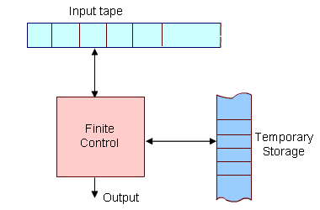
Diagrammatic representation of a generic automation.
The most important feature of the automaton is its control unit, which can be in any one of a finite number of interval states at any point. It can change state in some defined manner determined by a transition function.
Computing Theory Dr.A.Bazila Banu

Slide 12
Grammars
Grammars are concerned with the specifications of syntax rules
In everyday language, like English, we have a set of symbols (alphabet), a set of words constructed from these symbols, and a set of rules using which we can group the words to construct meaningful sentences.
  A typical rule can be defined as
  < sentence >< noun-phrase > < predicate >
Meaning that "a sentence can be constructed using a 'noun-phrase' followed by a predicate".
In particular,
  How do you indicate to a machine what programming language constructs are legal and which are not?
Computing Theory Dr.A.Bazila Banu

Slide 13
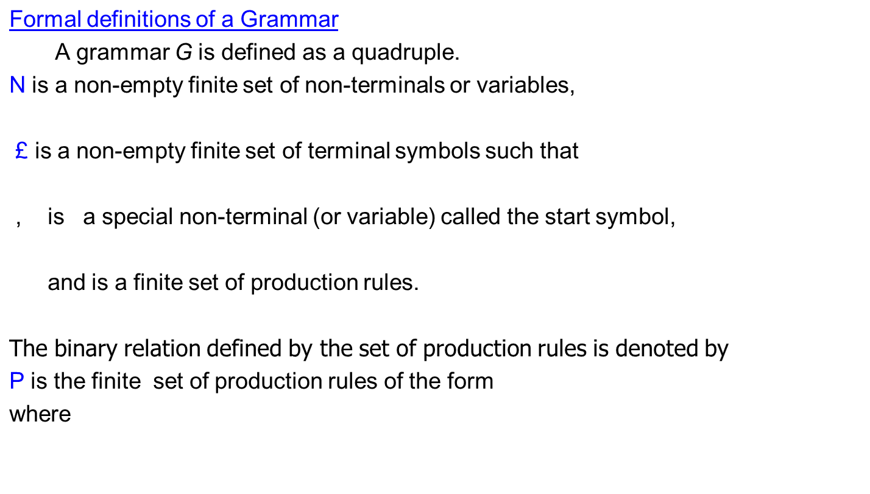

Grammars
Computing Theory Dr.A.Bazila Banu

Slide 14
Languages
A language over an alphabet ∑ is a subset of ∑*
Hence a language is just a “certain class” of strings over ∑
e.g.:
  ∑ = {0, 1}, L = {0, 01, 011, 0111, 01111,...}
  ∑ = {a,...z}, L = {ab,cd,efghi,s,z}
  ∑ = {0, 1}, L = { (representations of) primes}
  ∑ = C Tokens, L = { legal C programs }
  ∑ = {0, 1}, L = {strings containing at least 2 0’s}
  ∑ = {a,...z}, L = Ø
In general, the following format is used to specify a language:
  L = {w ∈ ∑* | w has property P}
Hence to define a language, two elements needed:
  building blocks / alphabets and
  rules for correct sequence of letters from alphabet
Computing Theory Dr.A.Bazila Banu

Slide 15
Kleene Star
/Kleene Closure
Kleene Star
Definition − The set ∑* is the infinite set of all possible strings of all possible lengths over ∑ including λ.
Representation − ∑* = ∑₀ ∪ ∑₁ ∪ ∑₂ ∪…….
Example − If ∑ = {a, b}, ∑*= {λ, a, b, aa, ab, ba, bb,………..}
Kleene Closure/Plus
Definition − The set ∑⁺ is the infinite set of all possible strings of all possible lengths over ∑ excluding λ.
Representation − ∑⁺ = ∑₀ ∪ ∑₁ ∪ ∑₂ ∪…….
∑⁺ = ∑* − { λ }
Example − If ∑ = { a, b } , ∑⁺ ={ a, b, aa, ab, ba, bb,………..}
Computing Theory Dr.A.Bazila Banu

Slide 16


Languages and Grammers
Formaly, for a given grammar
the language generated by G is
Computing Theory Dr.A.Bazila Banu

Slide 17
Computability
Computability is concerned with the fundamental limits of computation (in contrast with the resources view used in complexity).
In particular, it may be surprising to learn that there are some problems for which it can be proved that computers (at least in their current conception) cannot solve.
Computing Theory Dr.A.Bazila Banu

